Slide 1

Mission Analytics Exercise
Pikes Peak Data
Exploratory Data Analysis (Demographics)
By: Dhruv Singh
1.24.2022

Slide 2
To identify performance by division
Ph
Objective
Doing so will help benchmark individual performance using group performance

Slide 3
Overview of Data
Dataset: 2006 Pike’s Peak 10k Race
People:
Total Males: 1265, Total Females: 1105
Age Range: 9 years old to 84 years old
Performance:
Total Time, Range: 28 min to 110 min, Avg: 56 min
Pace, Range: 4 min/mi to 17 min/mi, Avg: 8 min

Slide 4
Analysis: Approach
Variables of Interest
Numeric Variables:
Net Time
Categorical Variables:
Age
Gender
Division
Disclaimer: data with age less than 5 years old, a total of 9 data points were treated as outliers/inaccurate/missing, and were imputed using back filling and forward filling

Slide 5
Summary: Findings
Male Mean: 52.13 minutes, Median: 51.38
Female Mean: 58.47 minutes, Median: 57.85
While highly correlated (0.9), Gun Time and Net Time are still significantly different (p-value<0.05)
Chris Doe’s Net Time is 6.491 minutes below the 10th percentile
Females in every division have a higher Net Time than Male.
The 14-19 age category performs best relative to other age categories, for each gender.

Slide 6
Race Results by Gender
Mean, Median, Mode, and Range of Net Time in Minutes
Metric | M | F
Mean | 52.13 | 58.47
Median | 51.38 | 57.85
Mode | 35.47, 47.08, 47.38, 49.80, 49.97, 51.33, 52.10, 52.70, 54.40, 56.72 | 48.10, 51.58, 52.98, 53.48, 59.00
Range | 71.85 | 73.85

Slide 7
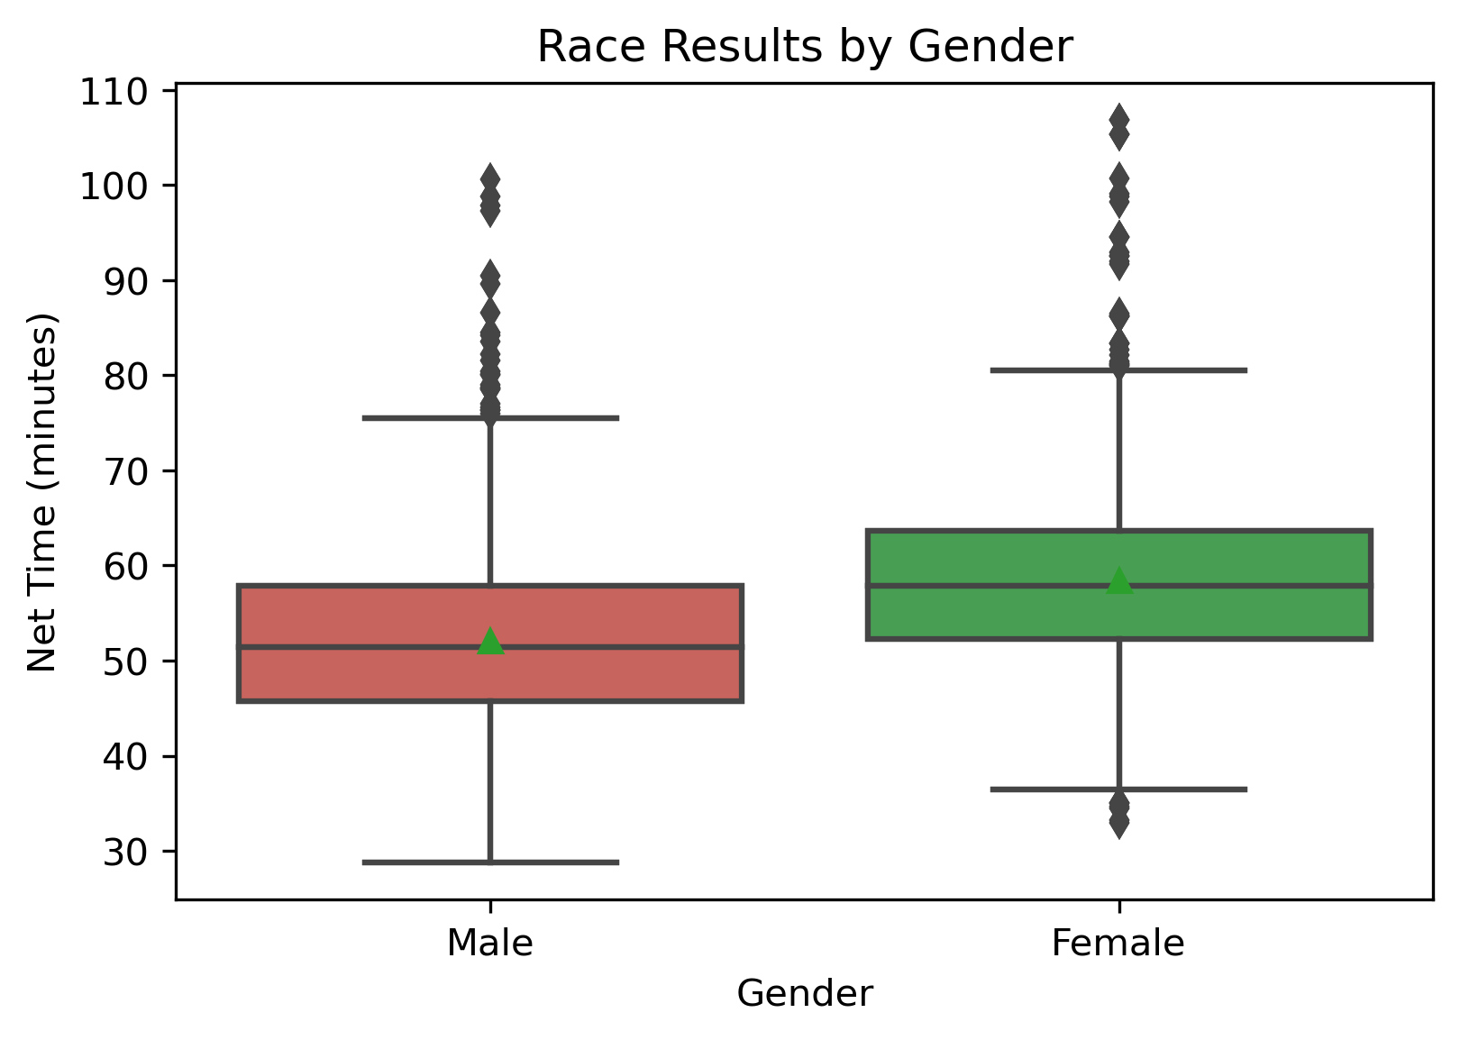
Race Results by Gender

Slide 8
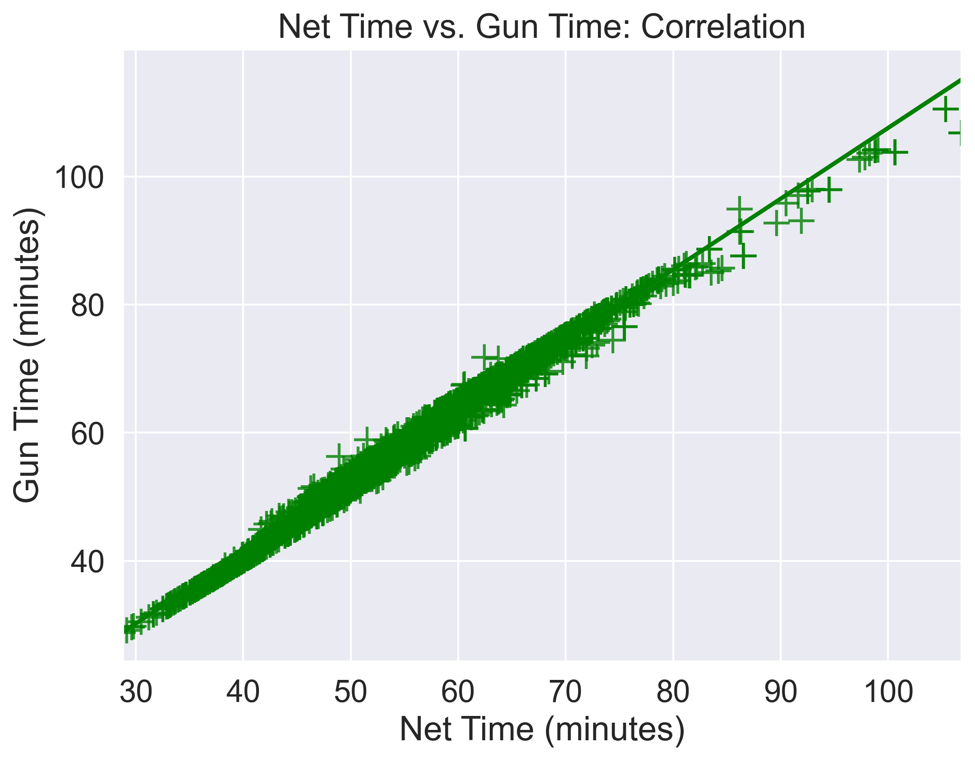
Gun Time vs. Net Time: Correlation
Pearson’s (r) Correlation Coefficient = 0.994857

Slide 9
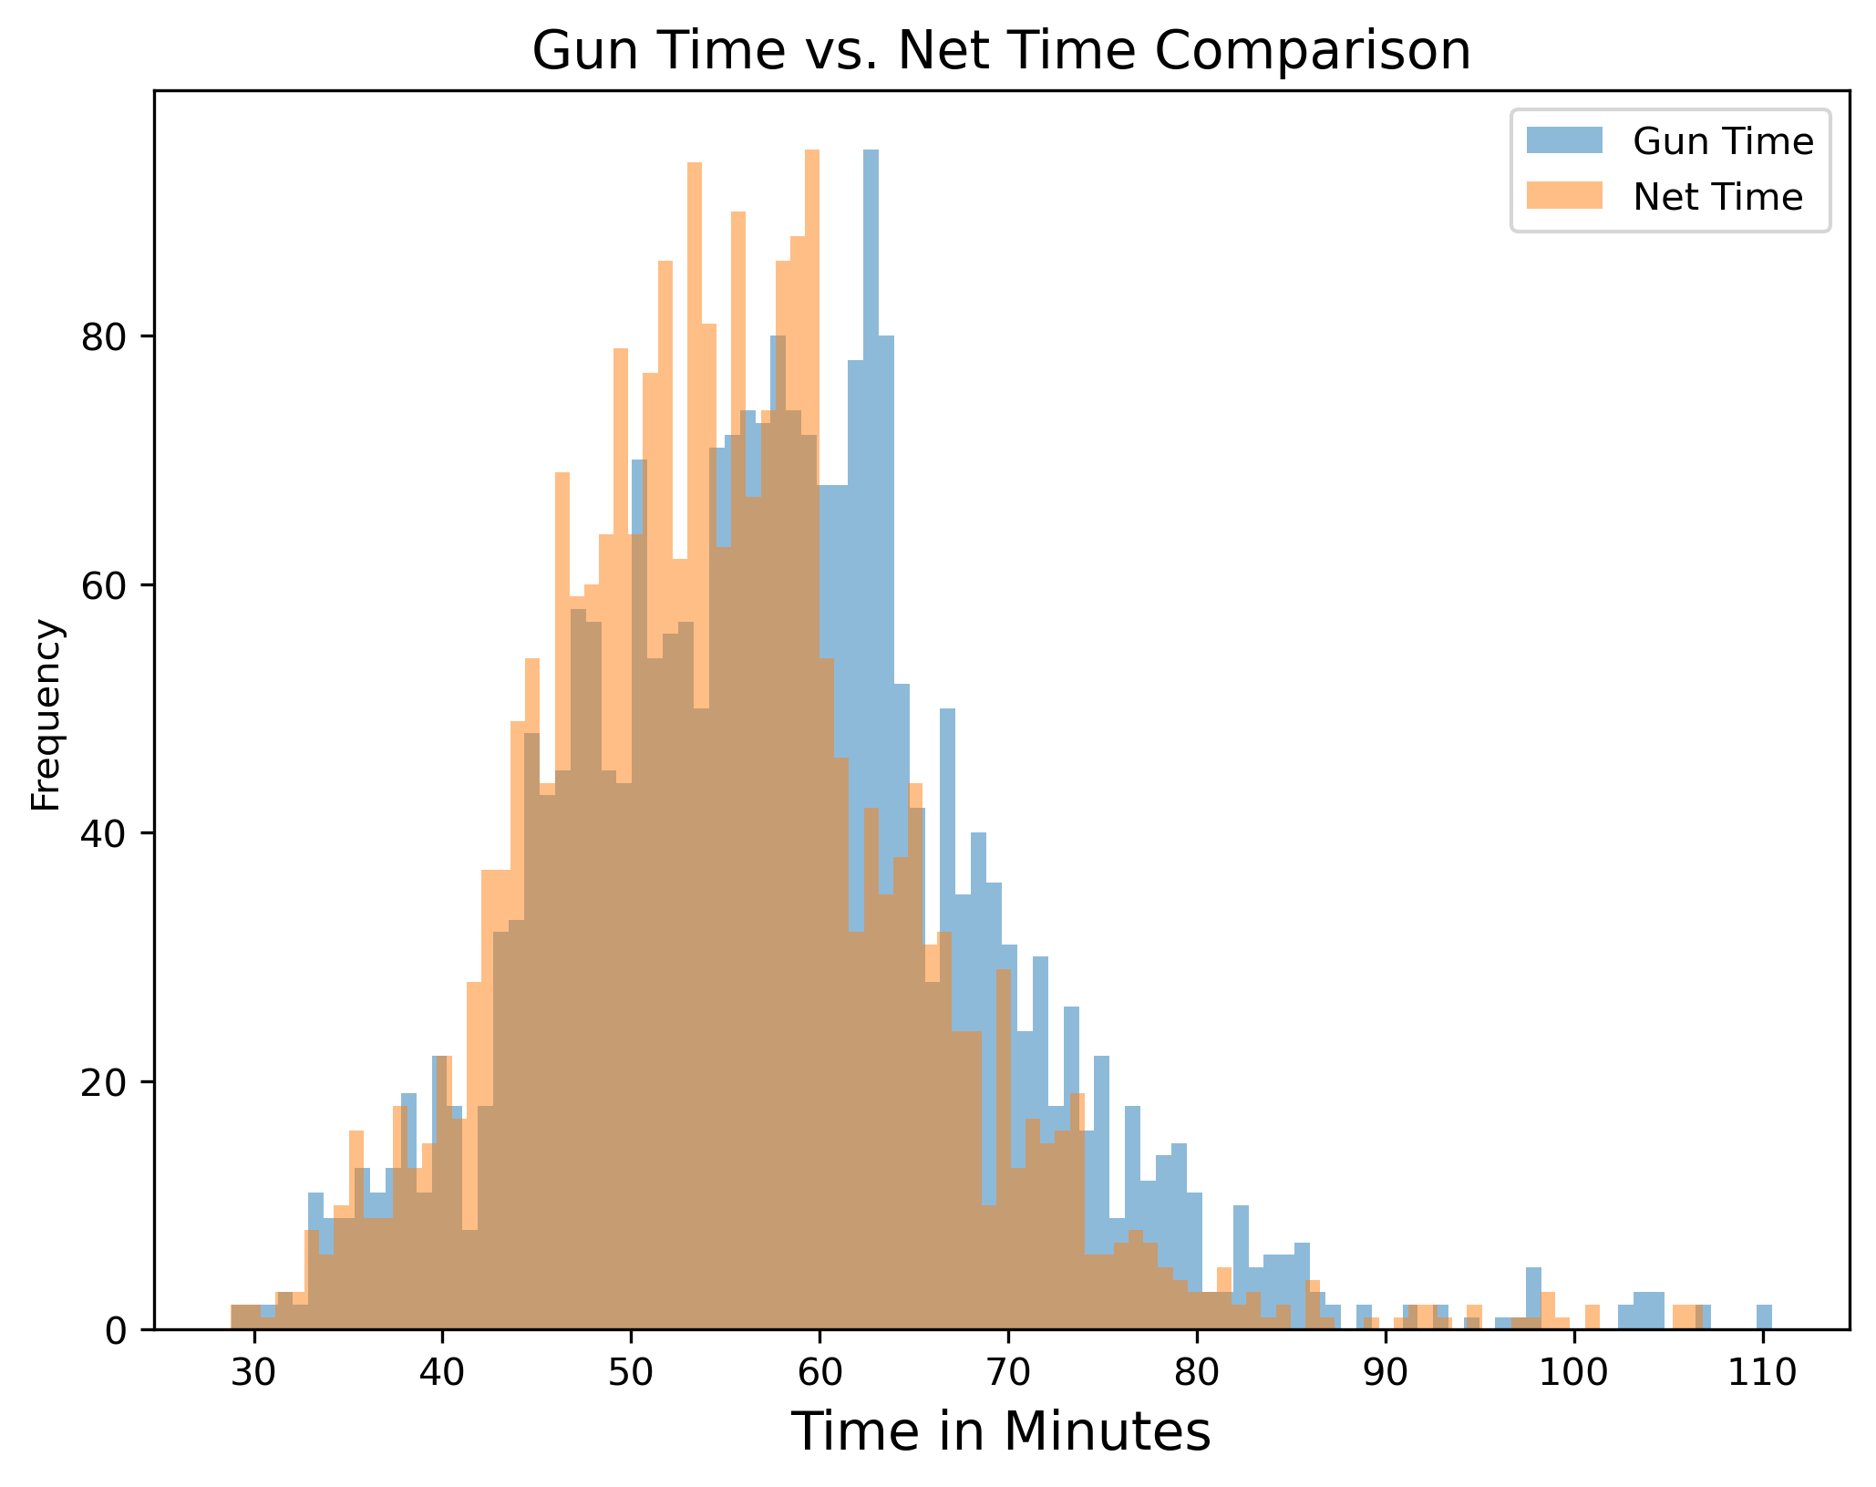
Gun Time vs. Net Time: T Test
T-Statistic: 9.03, P-Value2.38e-19 => Significantly Different

Slide 10
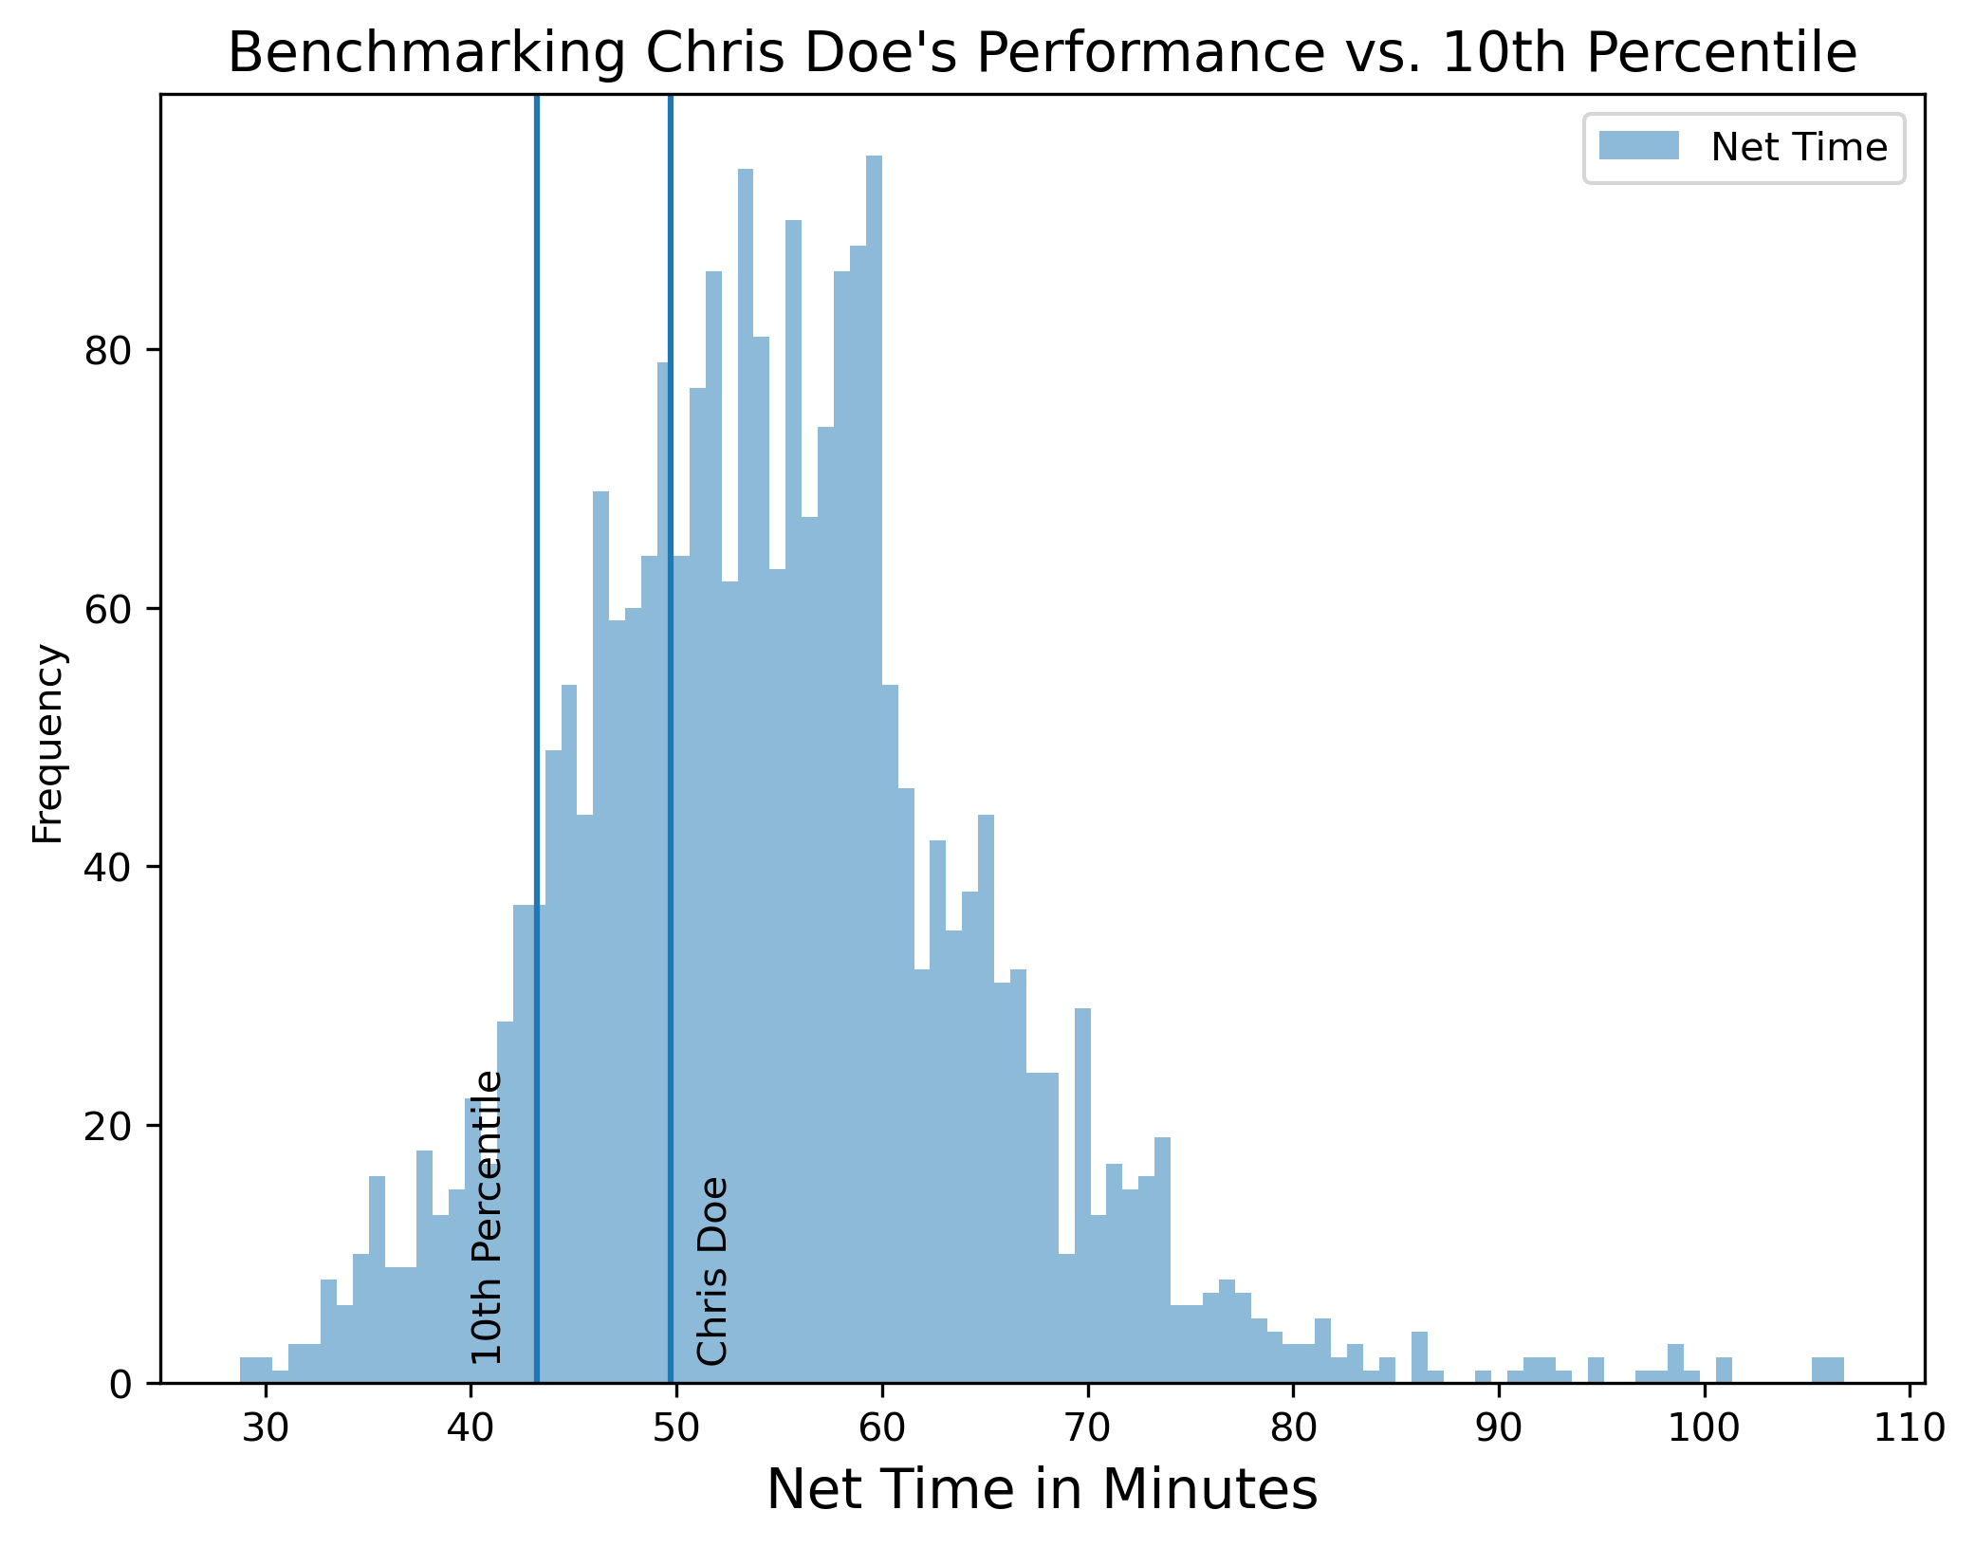
Chris Doe Performance (Benchmarking)
Abs(10th Percentile – Chris Doe) = 49.72 - 43.229 = 6.491 minutes

Slide 11
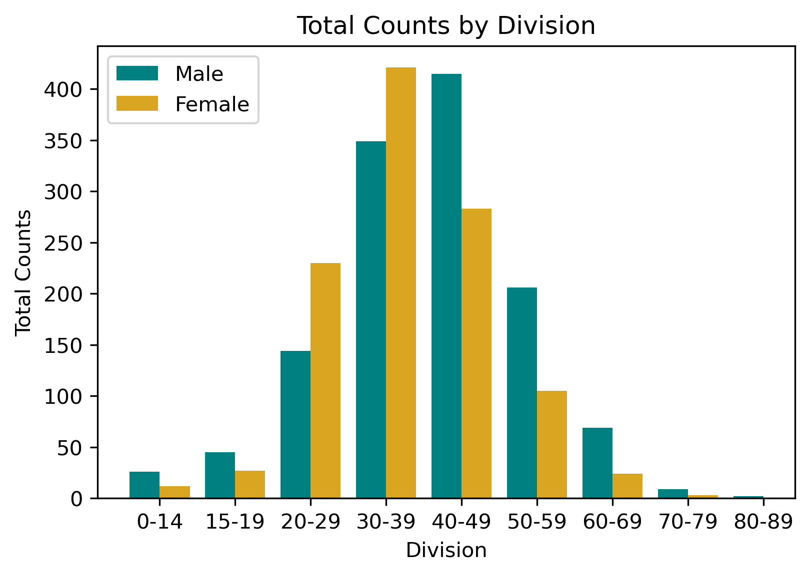
Race Results by Division
Division Totals
Age | F | M
0-14 | 12 | 26
15-19 | 27 | 45
20-29 | 230 | 144
30-39 | 421 | 349
40-49 | 283 | 415
50-59 | 105 | 206
60-69 | 24 | 69
70-79 | 3 | 9
80-89 |  | 2

Slide 12
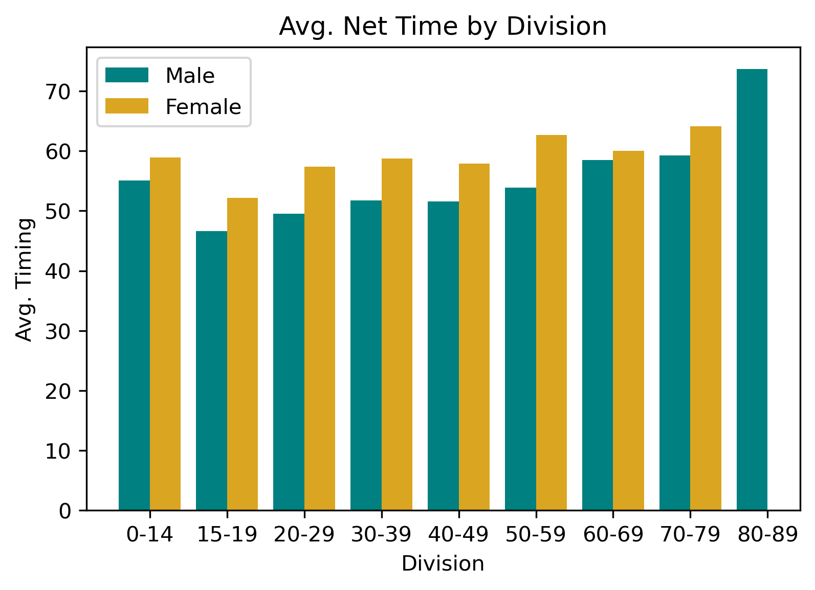
Division Performance
Division Averages
Age | F | M
0-14 | 58.89 | 55.04
15-19 | 52.21 | 46.65
20-29 | 57.36 | 49.52
30-39 | 58.71 | 51.72
40-49 | 57.87 | 51.61
50-59 | 62.68 | 53.9
60-69 | 60.01 | 58.47
70-79 | 64.11 | 59.26
80-89 |  | 73.66

Slide 13
Conclusion
Male performance metrics were lower than Females. This helps us contextualize performance.
Gun Time and Net Time, while highly correlated are significantly different. It may make sense to use one or the other, but not both.
Chris is 0.6 standard deviations below the 10th percentile. Knowing this helps him improve his performance.
Population age is normally distributed. High and low timings at extremes are accounted for by smaller populations, and may skew overall averages. Looking at averages for largest groups separately can tell us something.

Slide 14
Recommendations
Data Quality: for variables such as age. Quality control at front end prior to analysis
More data to augment existing data
Considering other variables such as pace, and metrics such as median to further analysis

